Slide 1
Lane Sense: The Future of Safe and Smart Driving
TSP - PROJECT DEMONSTRATION
Presented By:
1. Madakam Haritha – SKUCET Anantapur (BTech CSE)
2. Kolimi Imamulhaq
Guided By : Mr. Abdul Aziz

Slide 2
Problem Statement
Develop an Advanced Driver Assistance System (ADAS) for enhanced road safety through lane detection. The system should employ computer vision algorithms to accurately identify and track lanes in real-time, providing timely warnings and assistance to the driver in maintaining proper lane discipline.
Click

Slide 3
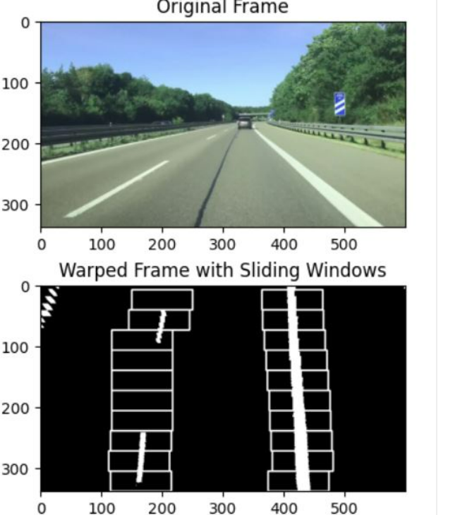
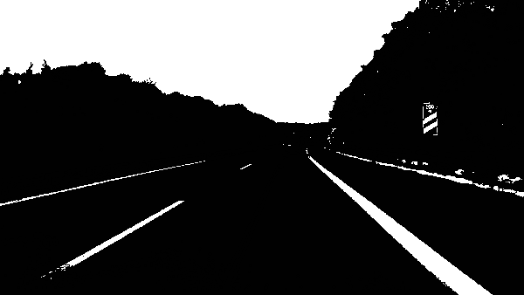
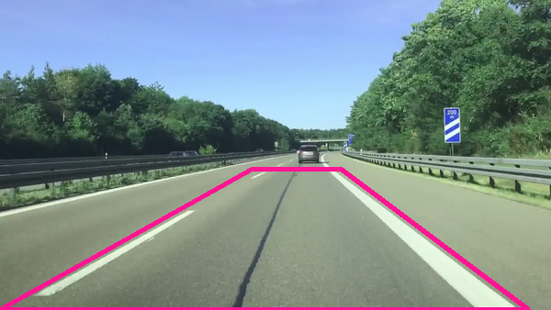
Proposed Solution
Isolate Pixels That Could Represent Lane Lines
Apply Perspective Transformation to Get a Bird’s Eye View
Set Sliding Windows for White Pixel Detection

Slide 4
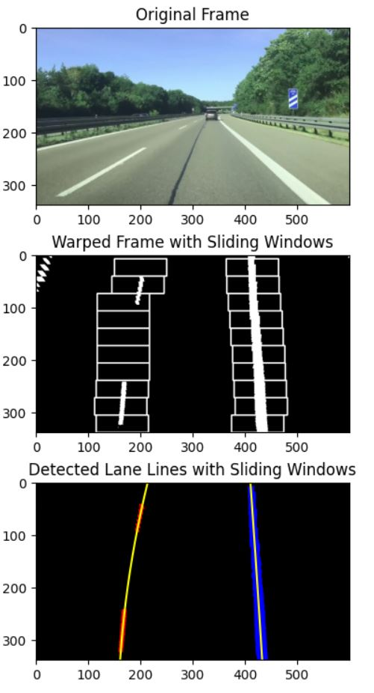
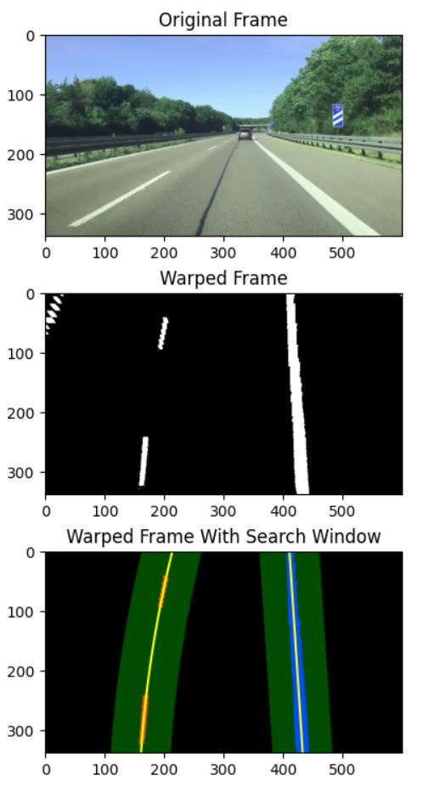
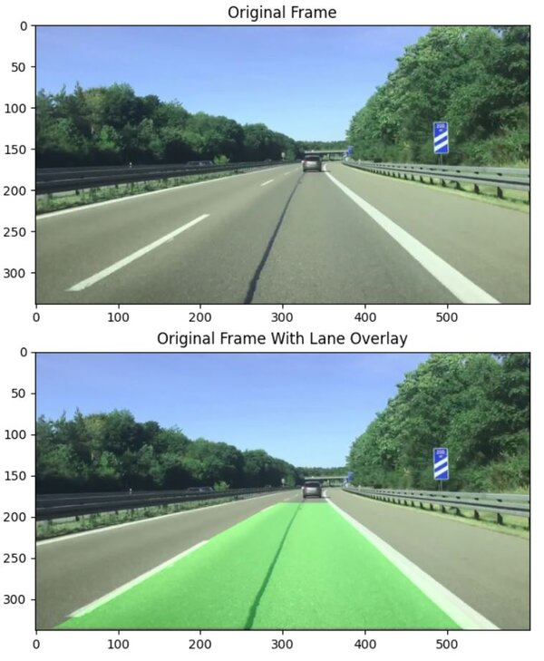
Here is an Example for a input image and respected output image shows that how lanes can be detected on the road.

Slide 5
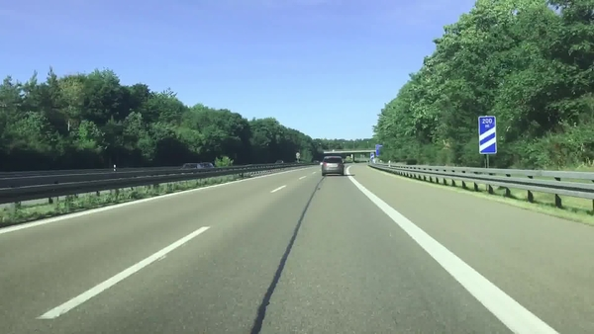
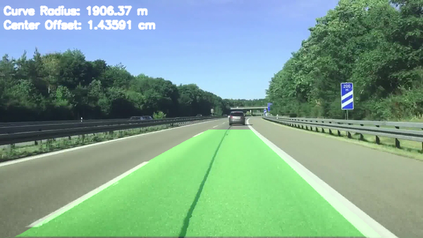
The Input image
Here is the output image

Slide 6
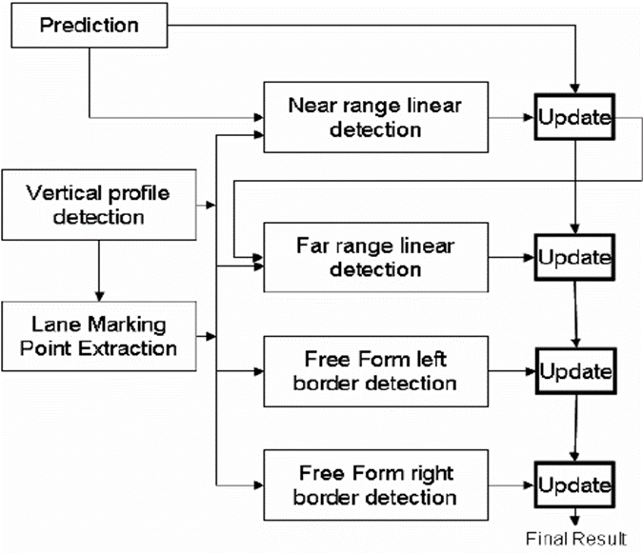
Algorithm & Deployment
Services and Tools used:
Opencv
Python programming Language
Matplotlib
Docopt
Moviepy

Slide 7
Conclusion & Future Scope
In conclusion, the lane detection project addresses the critical need for advanced computer vision solutions in autonomous vehicles and driver assistance systems.
Future scope:
Advanced Autonomous Vehicles
Multi-Lane and Complex Road Scenarios
Real-time Traffic Management

Slide 8
References
https://automaticaddison.com/the-ultimate-guide-to-real-time-lane-detection-using-opencv/
https://www.youtube.com/watch?v=iRTuCYx6quQ
https://colab.research.google.com/drive/1NJ6dLmSaRMnTqIYUTmzSmzPvQSsJRul#scrollTo=V6LhSijAc4a-

Slide 9
THANK YOU

